Slide 1
13
The Peripheral Nervous System and Reflex Activity: Part A

Slide 2
Peripheral Nervous System (PNS)
Provides links from and to world outside body
All neural structures outside brain
  Sensory receptors
  Peripheral nerves and associated ganglia
  Efferent motor endings

Slide 3
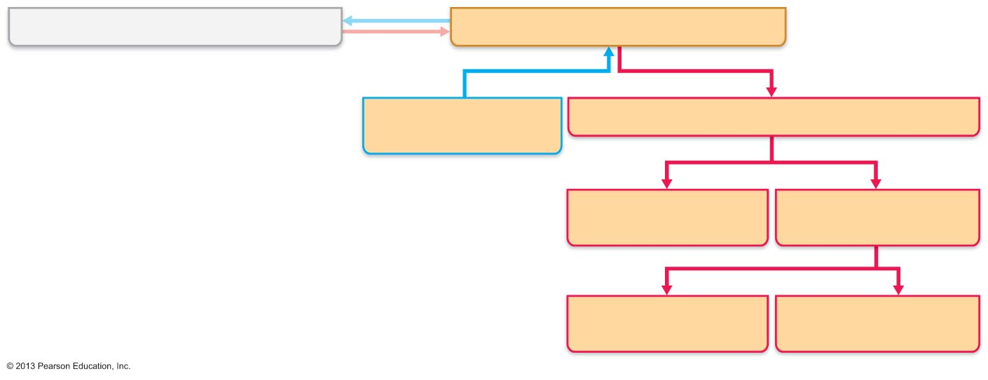
Figure 13.1 Place of the PNS in the structural organization of the nervous system.
Central nervous system (CNS)
Peripheral nervous system (PNS)
Sensory (afferent)
division
Motor (efferent) division
Somatic nervous
system
Autonomic nervous
system (ANS)
Sympathetic
division
Parasympathetic
division

Slide 4
Sensory Receptors
Specialized to respond to changes in environment (stimuli)
Activation results in graded potentials that trigger nerve impulses
Sensation (awareness of stimulus) and perception (interpretation of meaning of stimulus) occur in brain

Slide 5
Classification of Receptors
Based on
  Type of stimulus they detect
  Location in body
  Structural complexity

Slide 6
Classification by Stimulus Type
Mechanoreceptors—respond to touch, pressure, vibration, and stretch
Thermoreceptors—sensitive to changes in temperature
Photoreceptors—respond to light energy (e.g., retina)
Chemoreceptors—respond to chemicals (e.g., smell, taste, changes in blood chemistry)
Nociceptors—sensitive to pain-causing stimuli (e.g. extreme heat or cold, excessive pressure, inflammatory chemicals)

Slide 7
Classification by Location
Exteroceptors
  Respond to stimuli arising outside body
  Receptors in skin for touch, pressure, pain, and temperature
  Most special sense organs

Slide 8
Classification by Location
Interoceptors (visceroceptors)
  Respond to stimuli arising in internal viscera and blood vessels
  Sensitive to chemical changes, tissue stretch, and temperature changes
  Sometimes cause discomfort but usually unaware of their workings

Slide 9
Classification by Location
Proprioceptors
  Respond to stretch in skeletal muscles, tendons, joints, ligaments, and connective tissue coverings of bones and muscles
  Inform brain of one's movements

Slide 10
Classification by Receptor Structure
Simple receptors for general senses
  Tactile sensations (touch, pressure, stretch, vibration), temperature, pain, and muscle sense
  Modified dendritic endings of sensory neurons
Receptors for special senses
  Vision, hearing, equilibrium, smell, and taste (Chapter 15)

Slide 11
Simple Receptors of the General Senses
Either nonencapsulated (free) or encapsulated
Nonencapsulated (free) nerve endings
  Abundant in epithelia and connective tissues
  Most nonmyelinated, small-diameter group C fibers; distal endings have knoblike swellings
  Respond mostly to temperature and pain; some to pressure-induced tissue movement; itch

Slide 12
Simple Receptors of the General Senses
Thermoreceptors
  Cold receptors (10–40ºC); in superficial dermis
  Heat receptors (32–48ºC); in deeper dermis
  Outside those temperature ranges → nociceptors activated → pain

Slide 13
Unencapsulated Dendritic Endings
Nociceptors
  Player in detection – vanilloid receptor
    Ion channel opened by heat, low pH, chemicals, e.g., capsaicin (red peppers)
  Respond to:
    Pinching, chemicals from damaged tissue, capsaicin

Slide 14
Other Nonencapsulated Dendritic Endings
Light touch receptors
  Tactile (Merkel) discs
  Hair follicle receptors

Slide 15
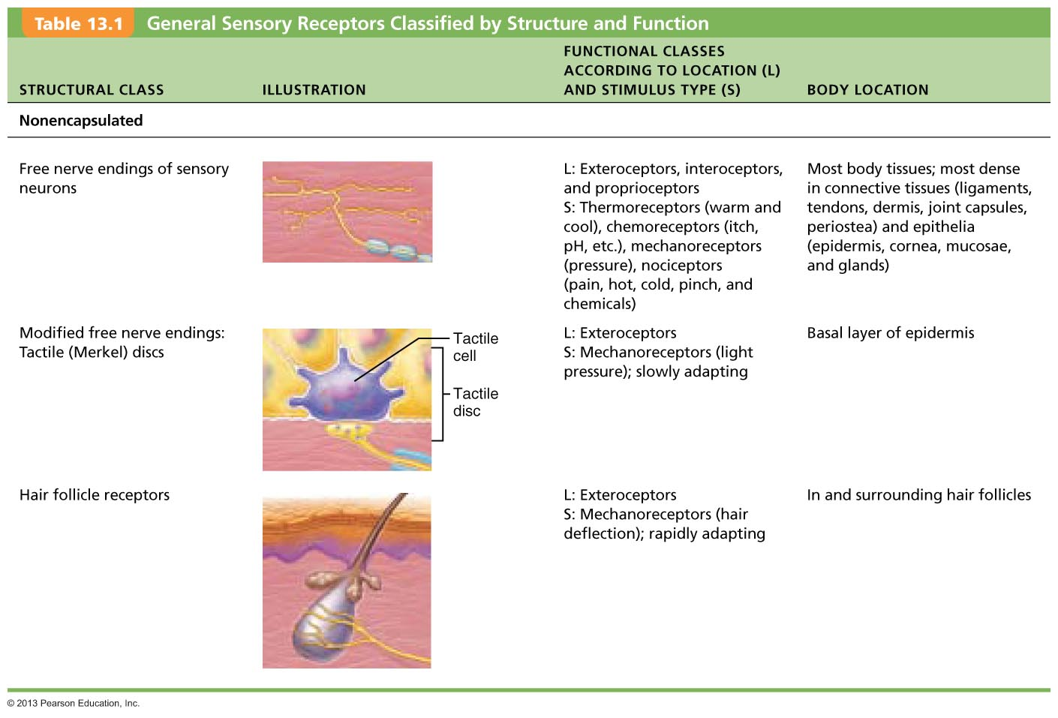
Table 13.1 General Sensory Receptors Classified by Structure and Function (1 of 3)

Slide 16
Encapsulated Dendritic Endings
~ All mechanoreceptors in connective tissue capsule
  Tactile (Meissner's) corpuscles—discriminative touch
  Lamellar (Pacinian) corpuscles—deep pressure and vibration
  Bulbous corpuscles (Ruffini endings)—deep continuous pressure
  Muscle spindles—muscle stretch
  Tendon organs—stretch in tendons
  Joint kinesthetic receptors—joint position and motion

Slide 17
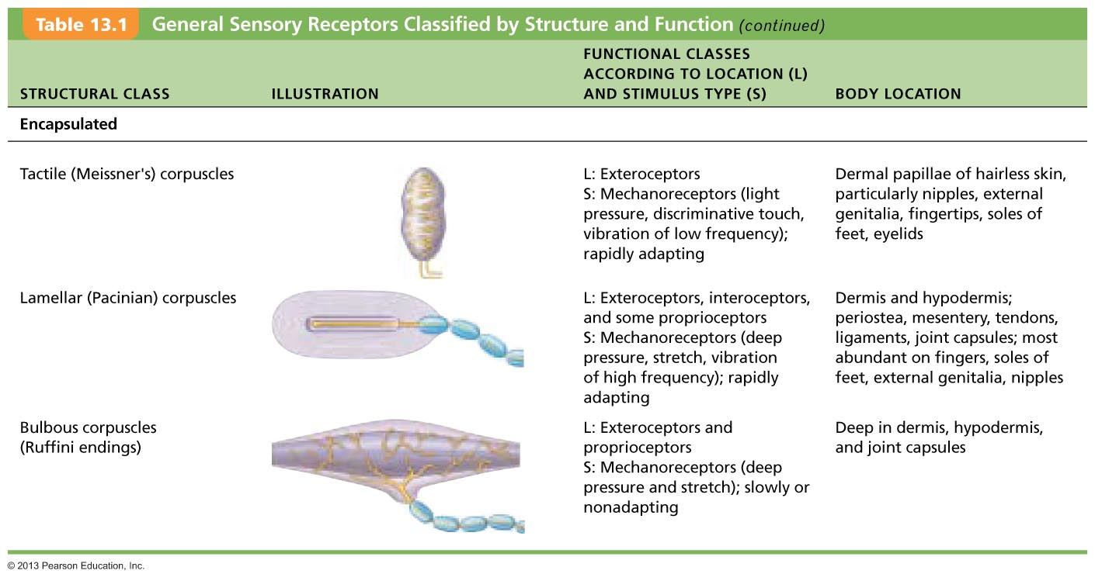
Table 13.1 General Sensory Receptors Classified by Structure and Function (2 of 3)

Slide 18
From Sensation to Perception
Survival depends upon sensation and perception
Sensation - the awareness of changes in the internal and external environment
Perception - the conscious interpretation of those stimuli

Slide 19
Sensory Integration
Somatosensory system – part of sensory system serving body wall and limbs
Receives inputs from
  Exteroceptors, proprioceptors, and interoceptors
Input relayed toward head, but processed along way

Slide 20
Sensory Integration
Levels of neural integration in sensory systems:
  1. Receptor level—sensory receptors
  2. Circuit level—processing in ascending pathways
  3. Perceptual level—processing in cortical sensory areas

Slide 21
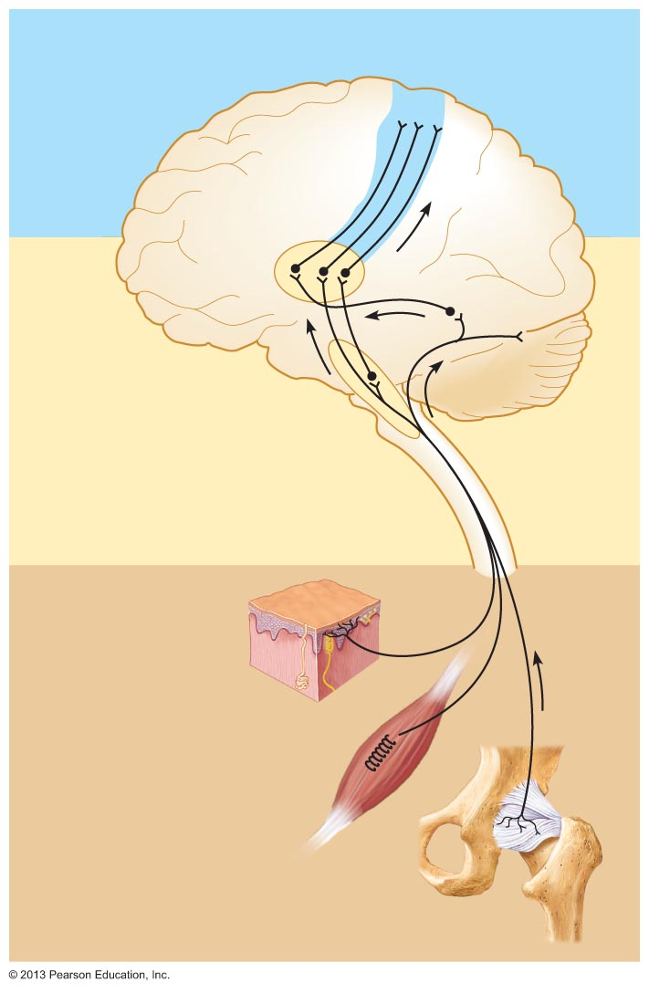
Figure 13.2 Three basic levels of neural integration in sensory systems.
3
Perceptual level (processing in cortical
sensory centers)
Motor
cortex
Somatosensory
cortex
Thalamus
Reticular
formation
Pons
Cerebellum
Circuit level
(processing in
ascending pathways)
2
Medulla
Spinal cord
Free nerve
endings (pain,
cold, warmth)
Muscle
spindle
Receptor level
(sensory reception and
transmission to CNS)
1
Joint
kinesthetic
receptor

Slide 22
Processing at the Receptor Level
To produce a sensation
  Receptors have specificity for stimulus energy
  Stimulus must be applied in receptive field
  Transduction occurs
    Stimulus changed to graded potential
      Generator potential or receptor potential
  Graded potentials must reach threshold → AP

Slide 23
Processing at the Receptor Level
In general sense receptors, graded potential called generator potential
Stimulus
⇓
Generator potential in afferent neuron
⇓
Action potential

Slide 24
Processing at the Receptor Level
In special sense organs:
Stimulus
⇓
Graded potential in receptor cell called
receptor potential
⇓
Affects amount of neurotransmitter released
⇓
Neurotransmitters generate graded potentials in sensory neuron

Slide 25
Adaptation of Sensory Receptors
Adaptation is change in sensitivity in presence of constant stimulus
  Receptor membranes become less responsive
  Receptor potentials decline in frequency or stop

Slide 26
Adaptation of Sensory Receptors
Phasic (fast-adapting) receptors signal beginning or end of stimulus
  Examples - receptors for pressure, touch, and smell
Tonic receptors adapt slowly or not at all
  Examples - nociceptors and most proprioceptors

Slide 27
Processing at the Circuit Level
Pathways of three neurons conduct sensory impulses upward to appropriate cortical regions
First-order sensory neurons
  Conduct impulses from receptor level to spinal reflexes or second-order neurons in CNS
Second-order sensory neurons
  Transmit impulses to third-order sensory neurons
Third-order sensory neurons
  Conduct impulses from thalamus to the somatosensory cortex (perceptual level)

Slide 28
Processing at the Perceptual Level
Interpretation of sensory input depends on specific location of target neurons in sensory cortex
Aspects of sensory perception:
  Perceptual detection—ability to detect a stimulus (requires summation of impulses)
  Magnitude estimation—intensity coded in frequency of impulses
  Spatial discrimination—identifying site or pattern of stimulus (studied by two-point discrimination test)

Slide 29
Main Aspects of Sensory Perception
Feature abstraction—identification of more complex aspects and several stimulus properties
Quality discrimination—ability to identify submodalities of a sensation (e.g., sweet or sour tastes)
Pattern recognition—recognition of familiar or significant patterns in stimuli (e.g., melody in piece of music)

Slide 30
Figure 13.2 Three basic levels of neural integration in sensory systems.
3
Perceptual level (processing in cortical
sensory centers)
Motor
cortex
Somatosensory
cortex
Thalamus
Reticular
formation
Pons
Cerebellum
Circuit level
(processing in
ascending pathways)
2
Medulla
Spinal cord
Free nerve
endings (pain,
cold, warmth)
Muscle
spindle
Receptor level
(sensory reception and
transmission to CNS)
1
Joint
kinesthetic
receptor

Slide 31
Perception of Pain
Warns of actual or impending tissue damage → protective action
Stimuli include extreme pressure and temperature, histamine, K⁺, ATP, acids, and bradykinin
Impulses travel on fibers that release neurotransmitters glutamate and substance P
Some pain impulses are blocked by inhibitory endogenous opioids (e.g., endorphins)

Slide 32
Pain Tolerance
All perceive pain at same stimulus intensity
Pain tolerance varies
"Sensitive to pain" means low pain tolerance, not low pain threshold
Genes help determine pain tolerance, response to pain medications
  Research to allow genes to determine best pain treatment

Slide 33
Homeostatic Imbalance
Long-lasting/intense pain—hyperalgesia (pain amplification), chronic pain, and phantom limb pain
  Modulated by NMDA receptors—allow spinal cord to "learn" hyperalgesia
    Early pain management critical to prevent
Phantom limb pain—felt in limb no longer present
  Now use epidural anesthesia to reduce

Slide 34
Visceral and Referred Pain
Stimulation of visceral organ receptors
  Felt as vague aching, gnawing, burning
  Activated by tissue stretching, ischemia, chemicals, muscle spasms
Referred pain
  Pain from one body region perceived from different region
  Visceral and somatic pain fibers travel in same nerves; brain assumes stimulus from common (somatic) region
    E.g., left arm pain during heart attack

Slide 35
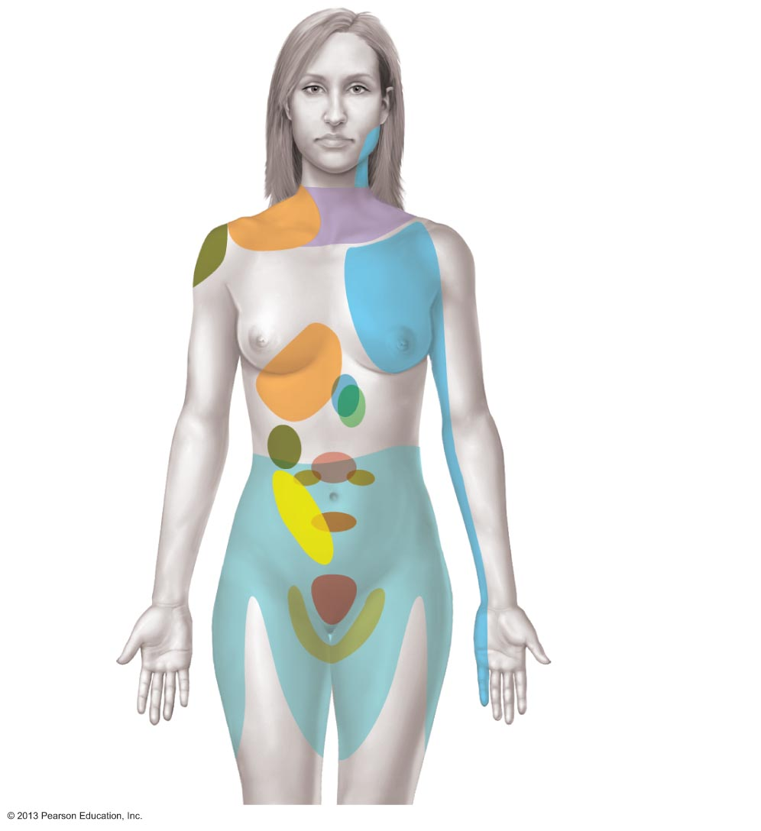
Figure 13.3 Map of referred pain.
Lungs and
diaphragm
Heart
Gallbladder
Liver
Appendix
Stomach
Pancreas
Small intestine
Ovaries
Colon
Kidneys
Urinary
bladder
Ureters

Slide 36
Structure of a Nerve
Cordlike organ of PNS
Bundle of myelinated and nonmyelinated peripheral axons enclosed by connective tissue

Slide 37
Structure of a Nerve
Connective tissue coverings include
  Endoneurium—loose connective tissue that encloses axons and their myelin sheaths
  Perineurium—coarse connective tissue that bundles fibers into fascicles
  Epineurium—tough fibrous sheath around a nerve

Slide 38
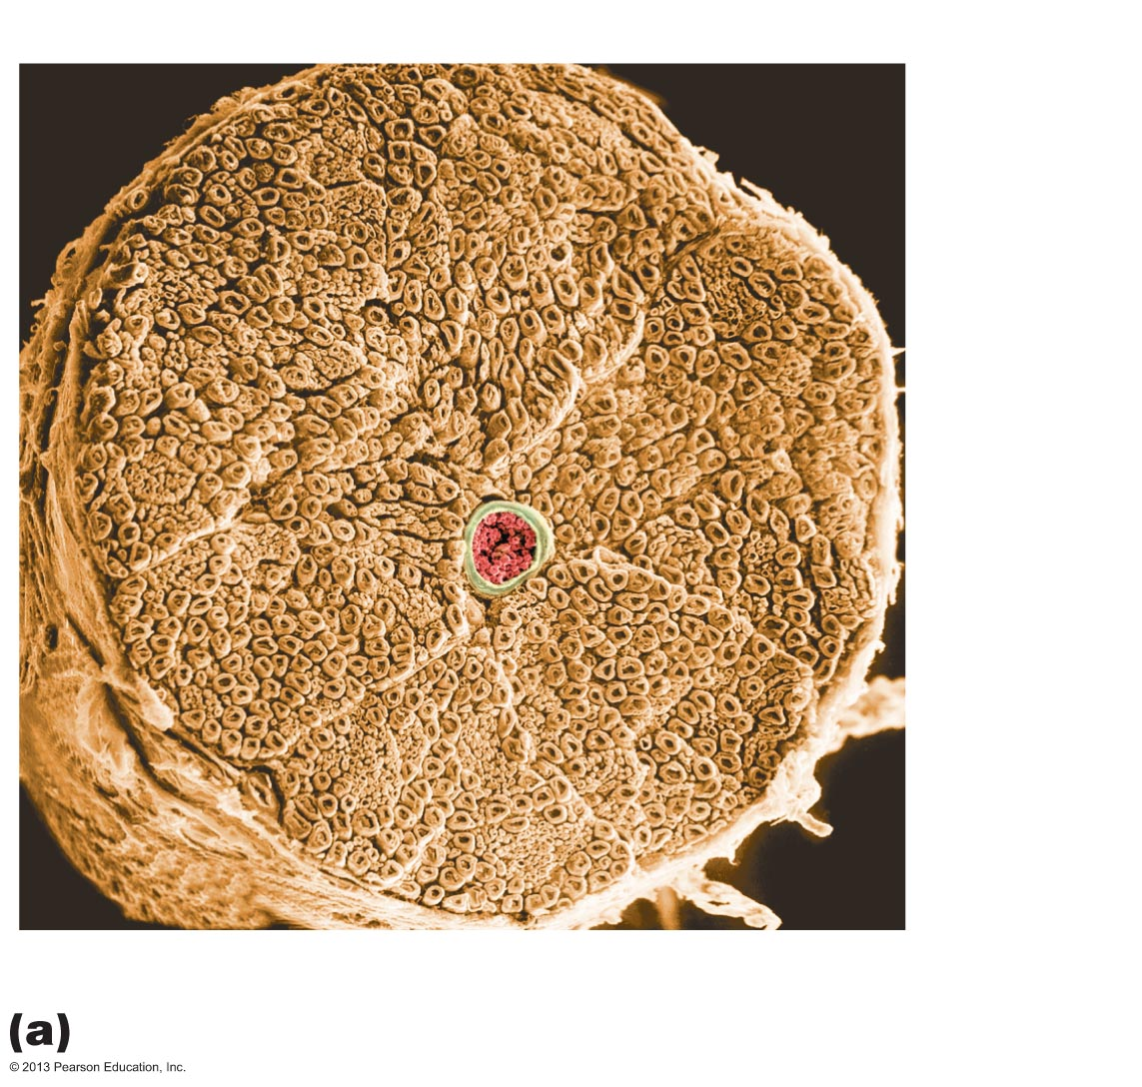
Figure 13.4a Structure of a nerve.
Endoneurium
Perineurium
Nerve
fibers
Blood
vessel
Fascicle
Epineurium

Slide 39
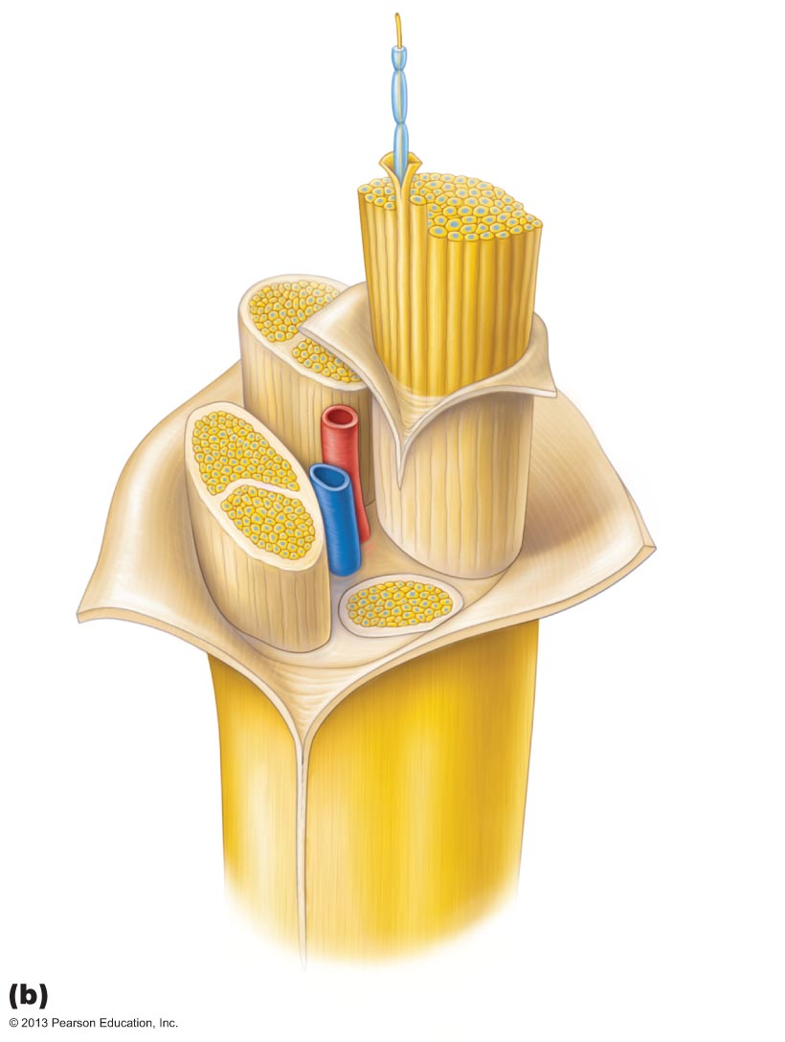
Figure 13.4b Structure of a nerve.
Axon
Myelin sheath
Endoneurium
Perineurium
Epineurium
Fascicle
Blood
vessels

Slide 40
Classification of Nerves
Most nerves are mixtures of afferent and efferent fibers and somatic and autonomic (visceral) fibers
Classified according to direction transmit impulses
  Mixed nerves – both sensory and motor fibers; impulses both to and from CNS
  Sensory (afferent) nerves – impulses only toward CNS
  Motor (efferent) nerves – impulses only away from CNS

Slide 41
Classification of Nerves
Pure sensory (afferent) or motor (efferent) nerves are rare; most mixed
Types of fibers in mixed nerves:
  Somatic afferent
  Somatic efferent
  Visceral afferent
  Visceral efferent
Peripheral nerves classified as cranial or spinal nerves

Slide 42
Ganglia
Contain neuron cell bodies associated with nerves in PNS
  Ganglia associated with afferent nerve fibers contain cell bodies of sensory neurons
    Dorsal root ganglia (sensory, somatic) (Chapter 12)
  Ganglia associated with efferent nerve fibers contain autonomic motor neurons
    Autonomic ganglia (motor, visceral) (Chapter 14)

Slide 43
Regeneration of Nerve Fibers
Mature neurons are amitotic but if soma of damaged nerve is intact, peripheral axon may regenerate
If peripheral axon damaged
  Axon fragments (Wallerian degeneration); spreads distally from injury
  Macrophages clean dead axon; myelin sheath intact
  Axon filaments grow through regeneration tube
  Axon regenerates; new myelin sheath forms
Greater distance between severed ends-less chance of regeneration

Slide 44
Regeneration of Nerve Fibers
Most CNS fibers never regenerate
CNS oligodendrocytes bear growth-inhibiting proteins that prevent CNS fiber regeneration
Astrocytes at injury site form scar tissue containing chondroitin sulfate that blocks axonal regrowth
Treatment
  Neutralizing growth inhibitors, blocking receptors for inhibitory proteins, destroying chondroitin sulfate promising

Slide 45
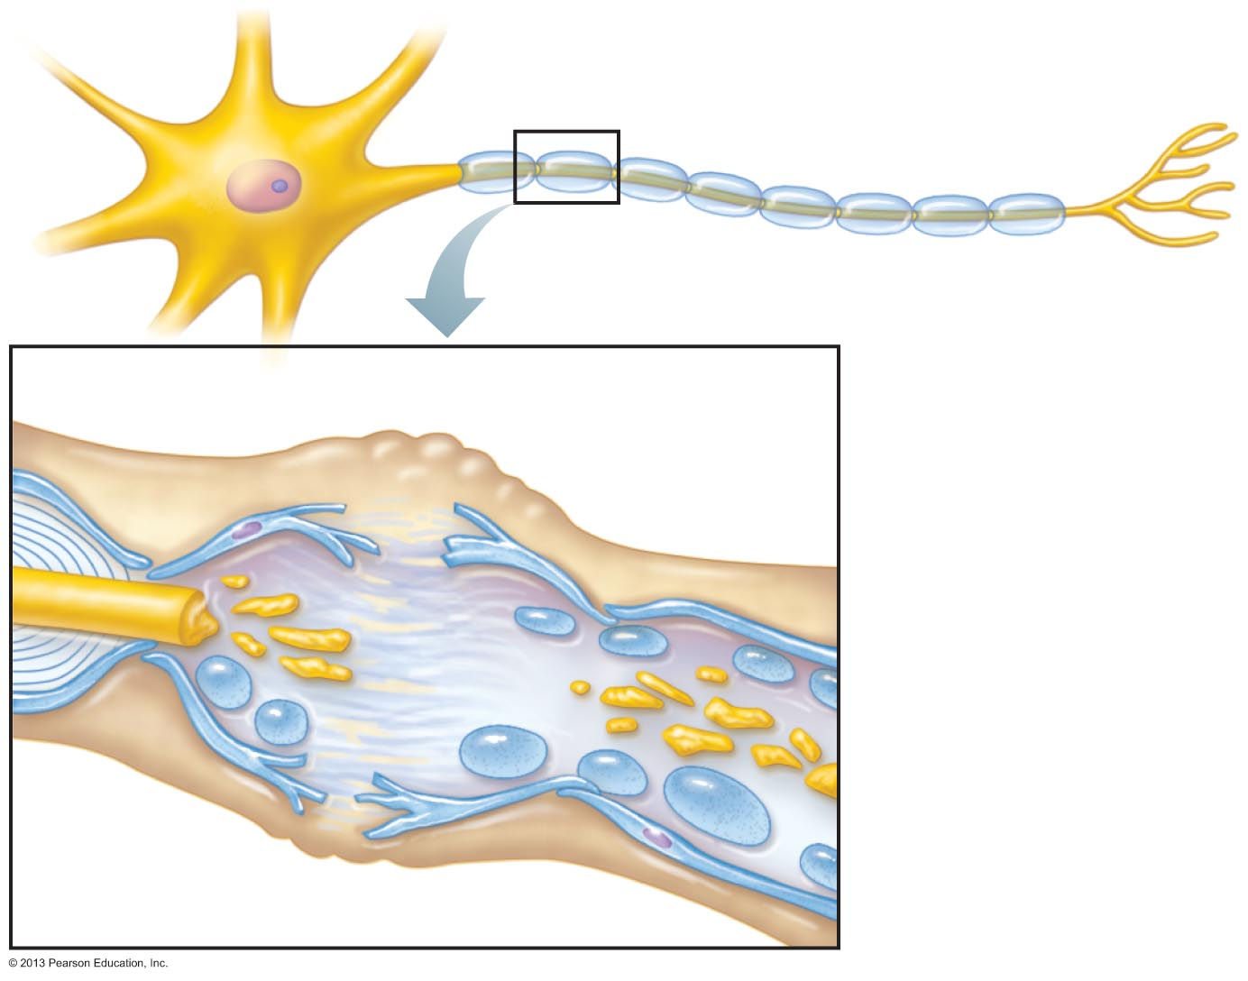
Figure 13.5 Regeneration of a nerve fiber in a peripheral nerve. (1 of 4)
Endoneurium
Schwann cells
1
The axon
becomes
fragmented at
the injury site.
Droplets
of myelin
Fragmented
axon
Site of nerve damage

Slide 46
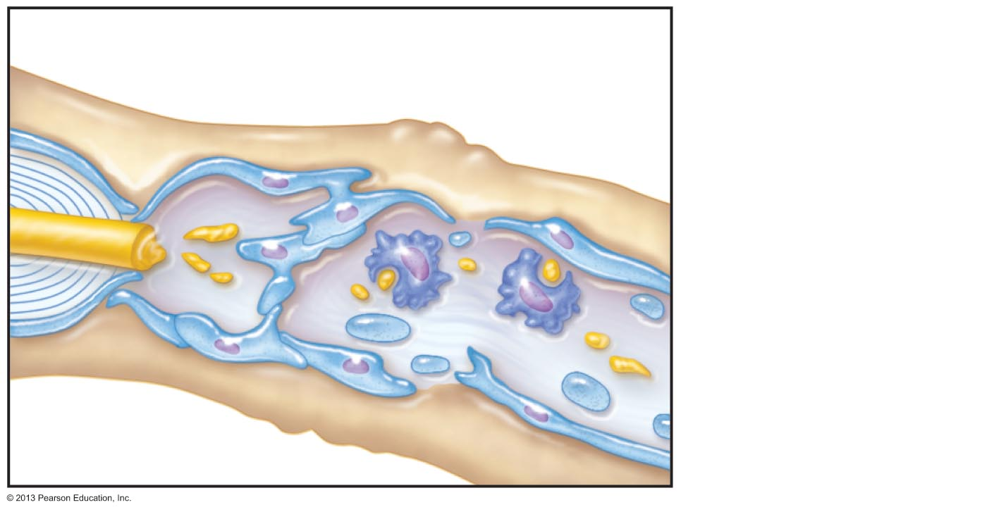
Figure 13.5 Regeneration of a nerve fiber in a peripheral nerve. (2 of 4)
2
Macrophages
clean out the dead
axon distal to the
injury.
Schwann cell
Macrophage

Slide 47
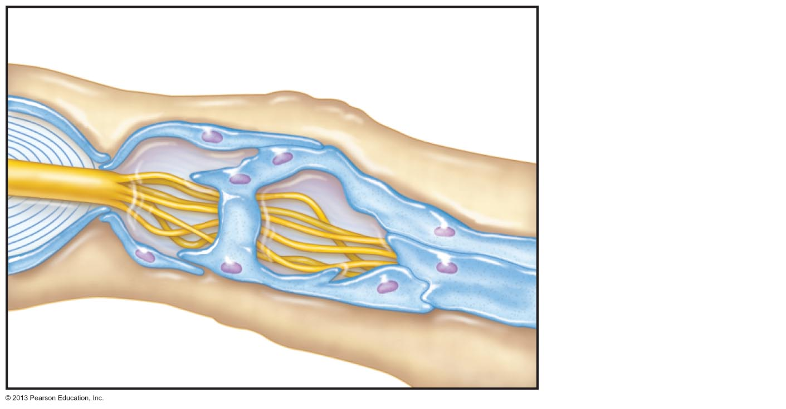
Figure 13.5 Regeneration of a nerve fiber in a peripheral nerve. (3 of 4)
3
Aligning Schwann cells
form regeneration tube
Axon sprouts,
or filaments, grow
through a
regeneration tube
formed by
Schwann cells.
Fine axon sprouts
or filaments

Slide 48
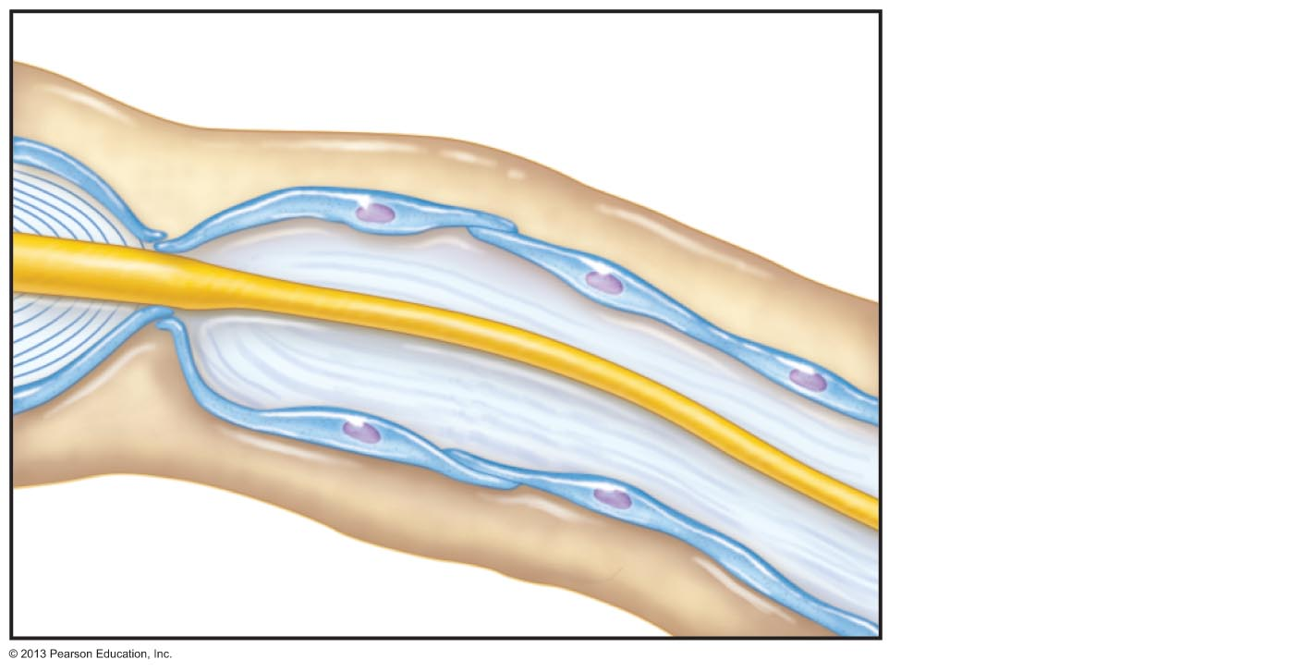
Figure 13.5 Regeneration of a nerve fiber in a peripheral nerve. (4 of 4)
4
Schwann cell
New myelin
sheath forming
The axon
regenerates and a
new myelin sheath
forms.
Single enlarging
axon filament

